Slide 1
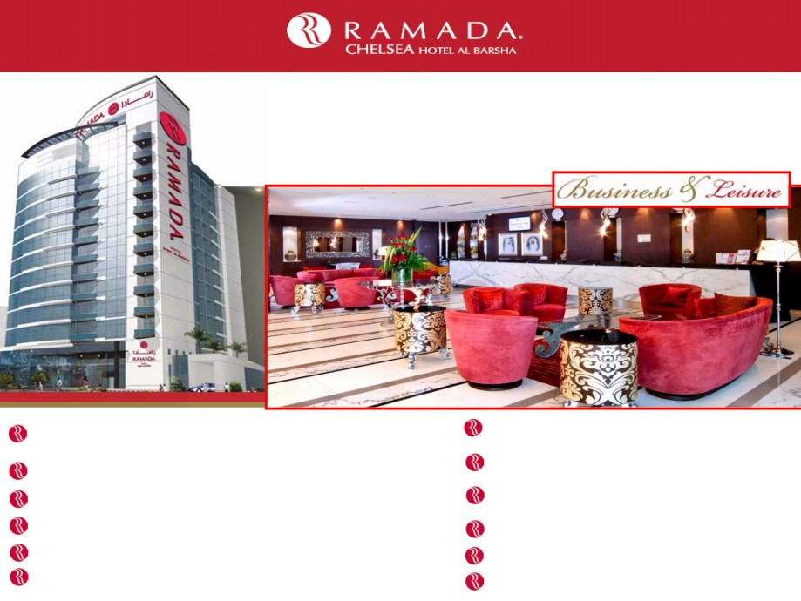
Ramada Chelsea Hotel Al Barsha is a brand new 4 star deluxe hotel, ideally
located in the heart of New Dubai, in close proximity to the city’s major
landmarks and attractions making it ideal choice for business or leisure traveler.
With 277 well appointed Deluxe Rooms and 11 Junior Suites and 11 Executive
Suite, Large conference and Banquet facility for up to 200 guests.
299 ultra-stylish elegantly furnished rooms / suites which offer
breathtaking views of Dubai city.
25 Km from Dubai International Airport and 94 Km from
Abu Dhabi Airport.
500 meters away from Mall of the Emirates and Dubai Metro Station.
Choice of restaurants with multiple cuisines and room service.
Health Club and Spa with Treatment rooms.
Outdoor temperature controlled swimming pool and
outdoor jacuzzi.
Complimentary underground parking.
Steam and sauna rooms.
Valet parking.
State of the art gymnasium.
Hair Dressing Salon.
Wireless internet availability throughout.

Slide 2
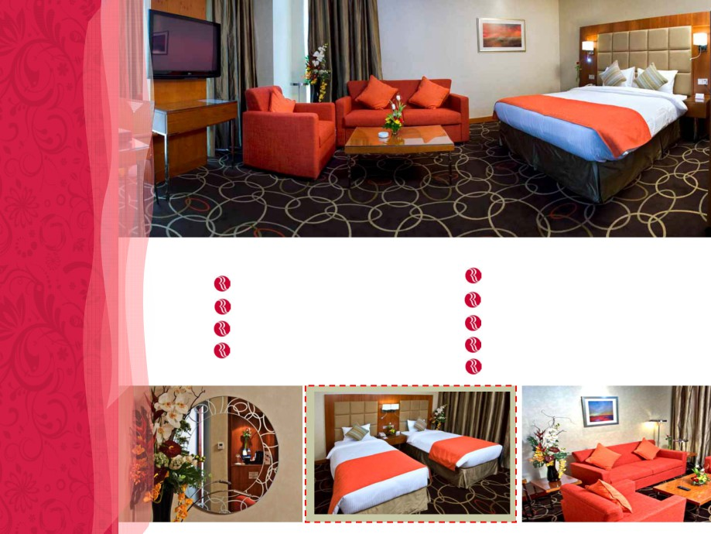
Guest Room Facilities
Tea and coffee making facilities in all rooms
Wifi access (chargeable)
Safe deposit box
Minibar in all the rooms
LCD TV with International Channels
Smoking and non smoking rooms available
Voice Mail
Iron & Ironing board
DVD player (per request)

Slide 3
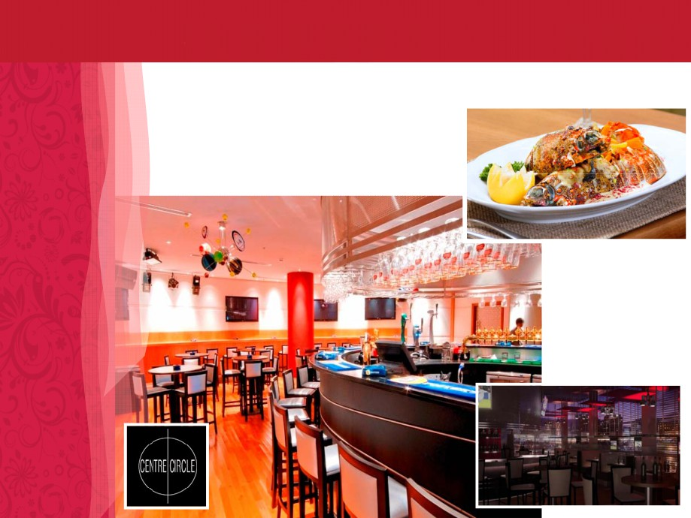
Restaurants
Our menu offers a wide array of mouth wateringly delicious foods with an Arabian flavor and flair to
satisfy the international gourmet. Our culinary experts guarantee a refined and sophisticated dining with
exquisite culinary inventions.
Center Circle - (Sports Bar) caters to all tastes and various
cuisines and enjoys latest televised sports with multiple screens.

Slide 4
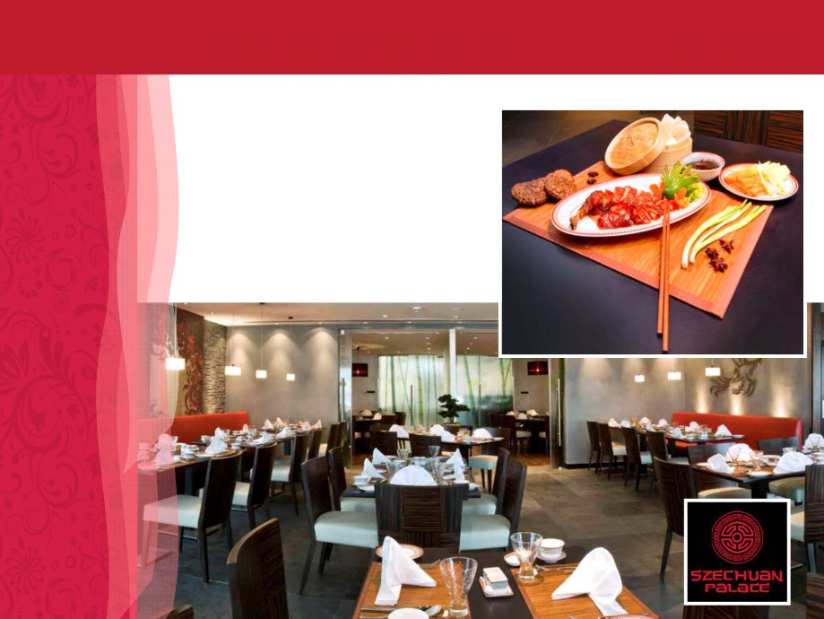
Restaurants
Szechuan Palace (Chinese Restaurant)
Authentic, flavorsome dishes from the
Chinese province of Szechuan.

Slide 5
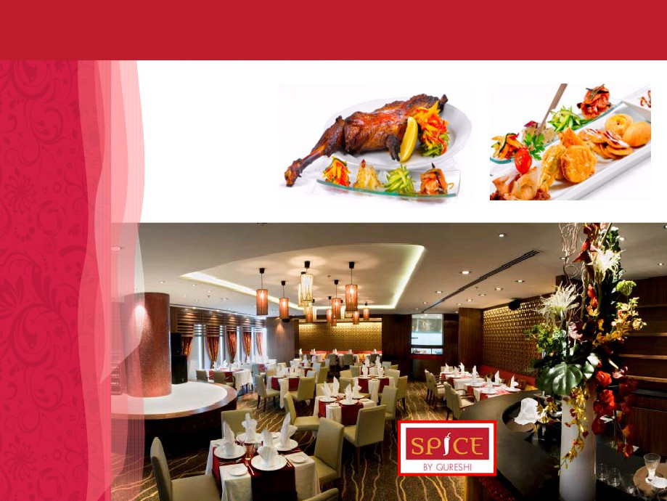
Restaurants
Spice by Qureshi
Indian Cuisine from one
of India’s most renowned
Chefs with live Indian
music.

Slide 6
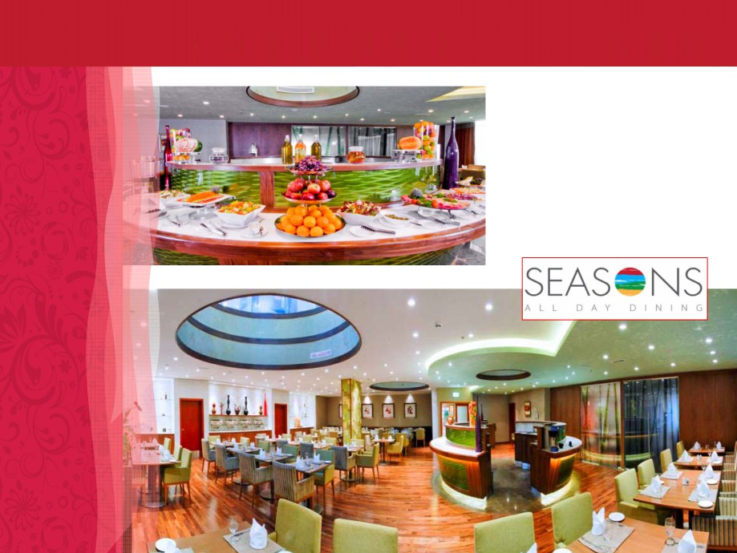
Restaurants
Seasons - All Day Dining Restaurant
An international style for Breakfast,
Lunch and Dinner either buffet or
a la Carte.

Slide 7

Restaurants
Mezz
Local Arabic cuisine with casual and
relaxing ambience.

Slide 8
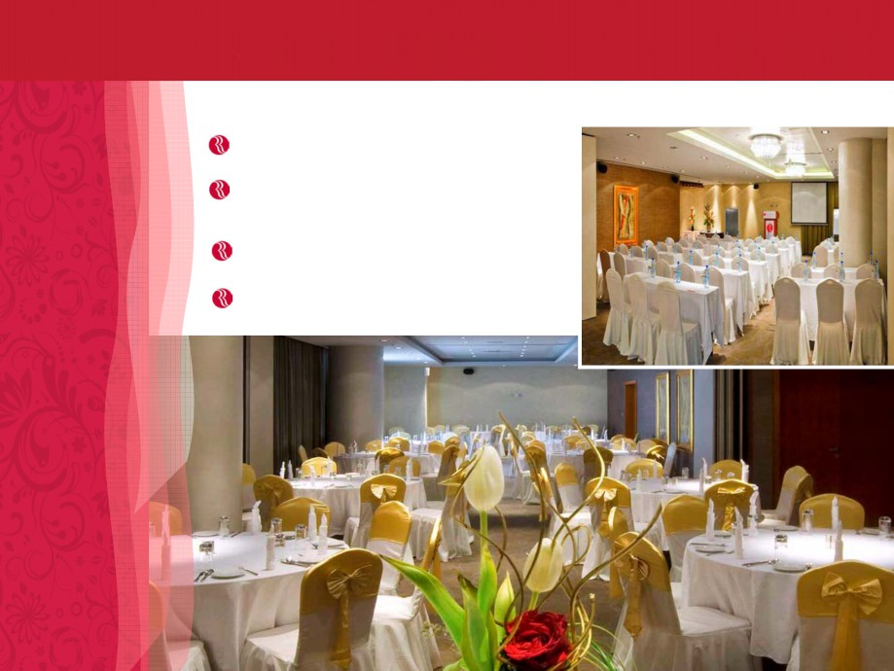
Banqueting / Conference Facility
Floating function capacity of 200 guests.
5 fully equipped rooms accommodating
20- 250 guests, ideal for meetings, seminars
and banquets.
State of the art built audio visual conference
Equipment.
All rooms with natural daylight.

Slide 9
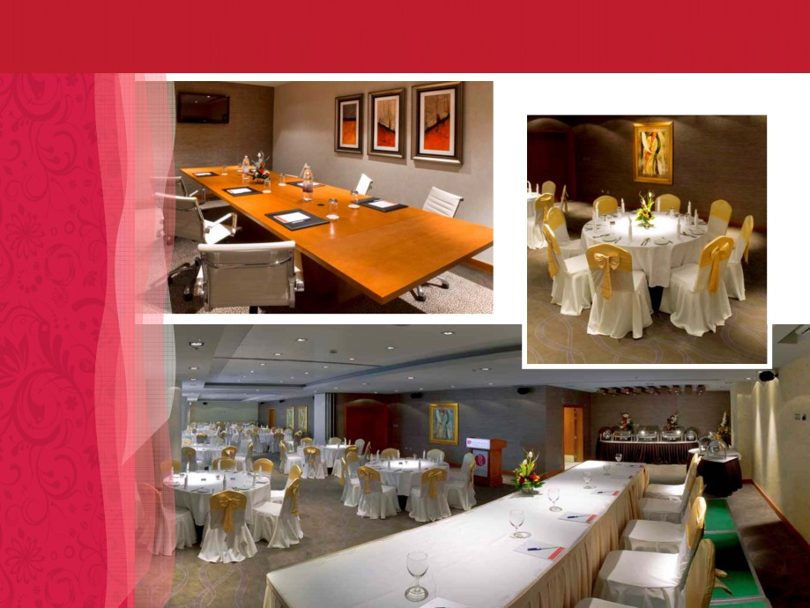
Banqueting / Conference Facility

Slide 10
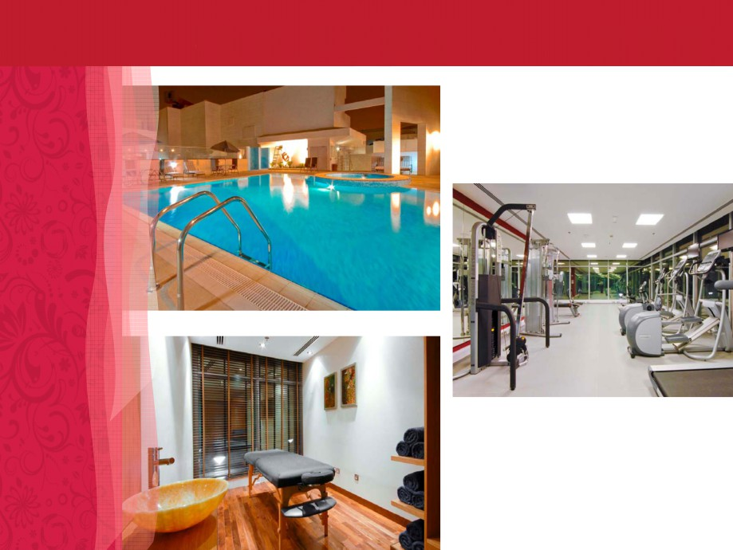
Leisure Facilities

Slide 11

RAMADA CHELSEA HOTEL AL BARSHA
P.O. Box 120257
Al Barsha, Dubai
United Arab Emirates
Tel. +971 4 501 9000
Fax. +971 4 501 9100
Email: info@ramadachelseadubai.com
www.ramadachelseadubai.com

Slide 12
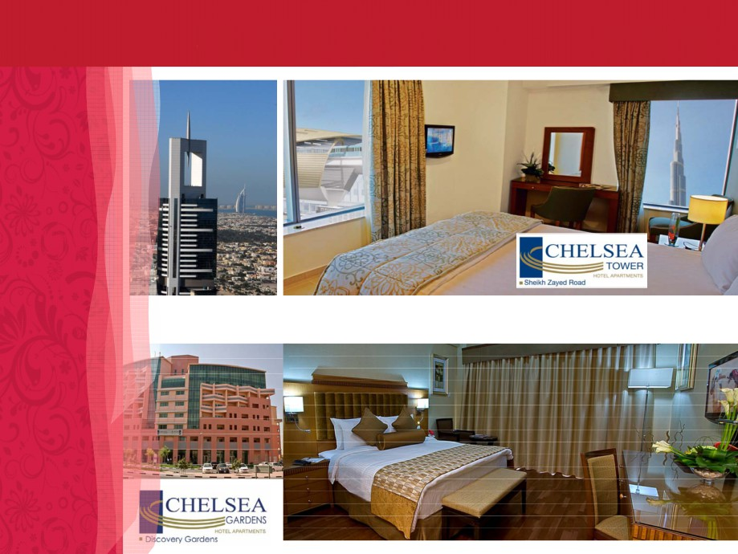
Other Properties :

Slide 13


